Slide 1
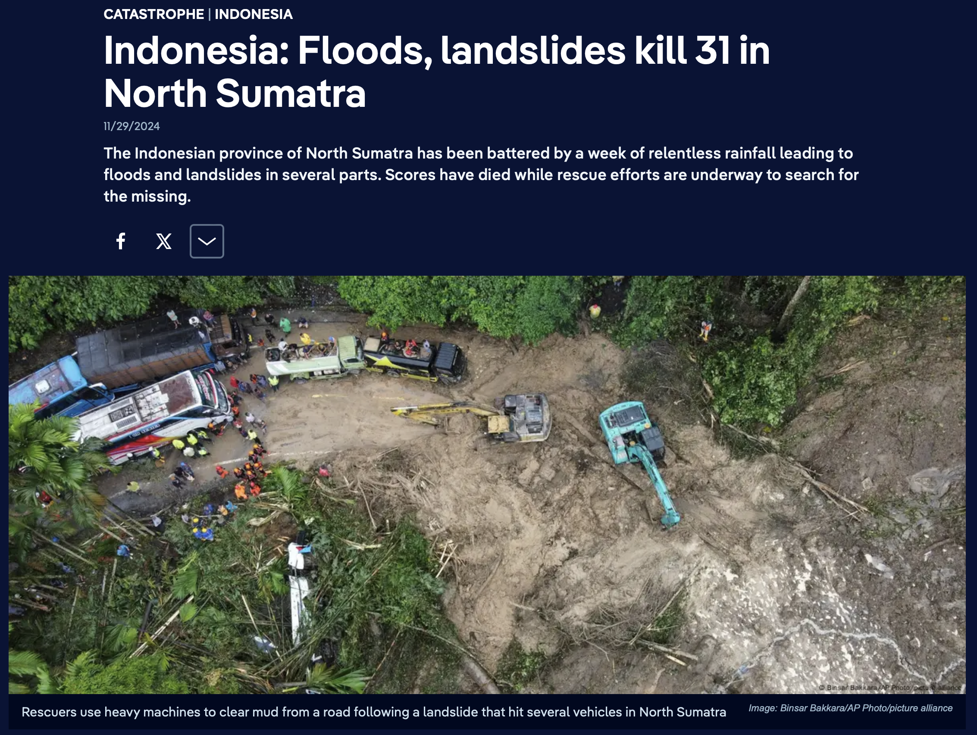
HazMiner
Dataset: geohydrological hazards worldwide (2017-2023)
Floods, landslides and flash floods
Method:
Online news articles
Processing using large language models
Processing at the paragraph level
Events: clustered paragraphs

Slide 2
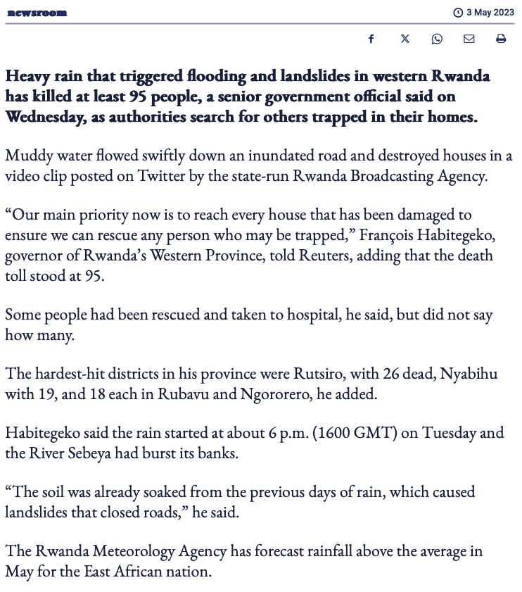
Notes:
https://in-cyprus.philenews.com/international/heavy-rain-floods-kill-at-least-95-in-rwanda/

Slide 3





flooding and landslides
Inondations et glissements de terrain
western Rwanda
L'ouest du Rwanda
killed at least 95 people
95 décès
Wednesday
Mercredi

Slide 4
The dataset
Paragraphs: data quantity
One hazard type
Location: latitude – longitude, bounding box
Timing: one time of the hazard event
Impact: fatalities, injured, homeless, missing, evacuated and affected
Events: data quality
Multiple paragraphs
One hazard type
Location: latitude – longitude, bounding box
Timing: start, time, and end
Impact
fatalities, injured, homeless, missing, evacuated and affected

Slide 5
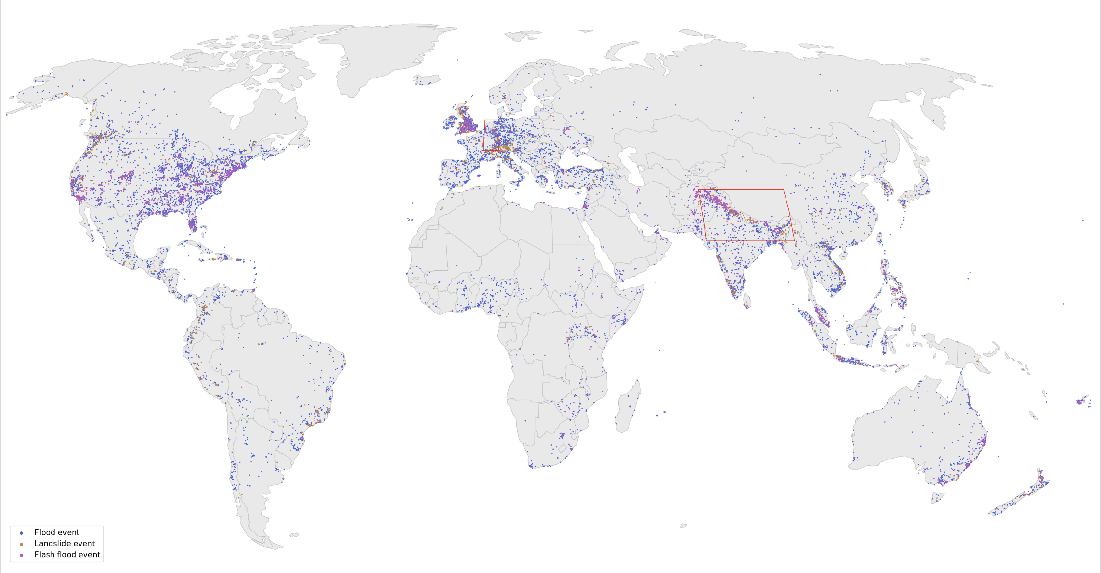

Slide 6
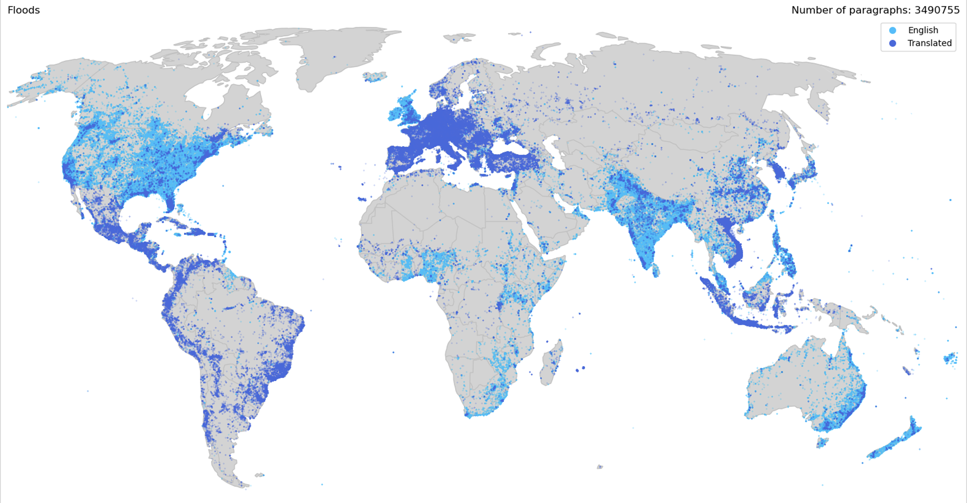

Slide 7
Ideas for the portal

Slide 8
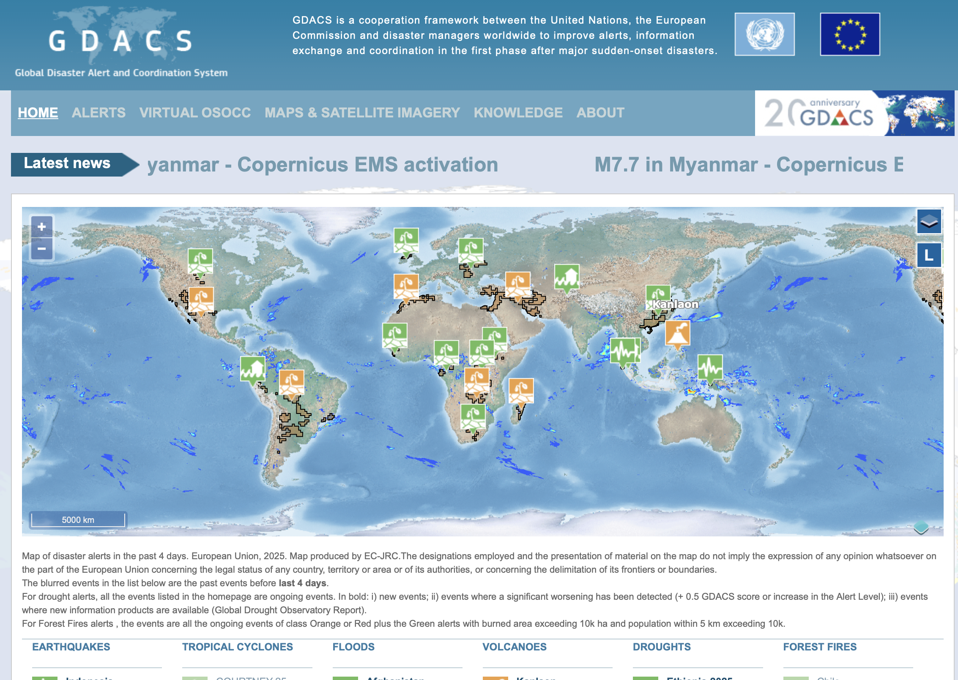
Existing platforms
https://gdacs.org/default.aspx
https://mapping.emergency.copernicus.eu
https://rsoe-edis.org/eventMap
https://georiska.africamuseum.be/en/co_webgis

Slide 9
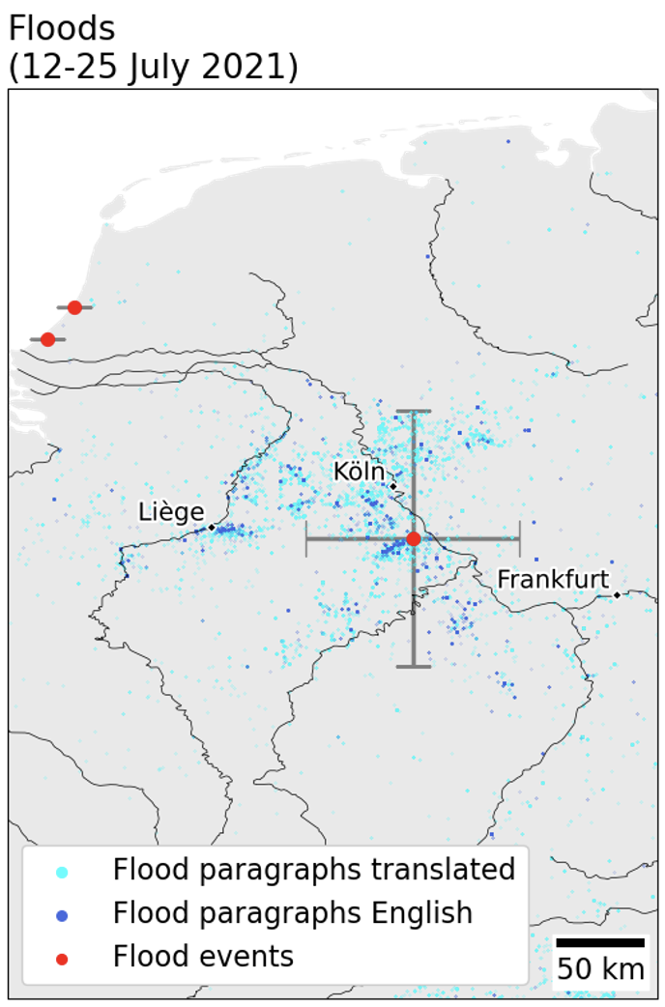
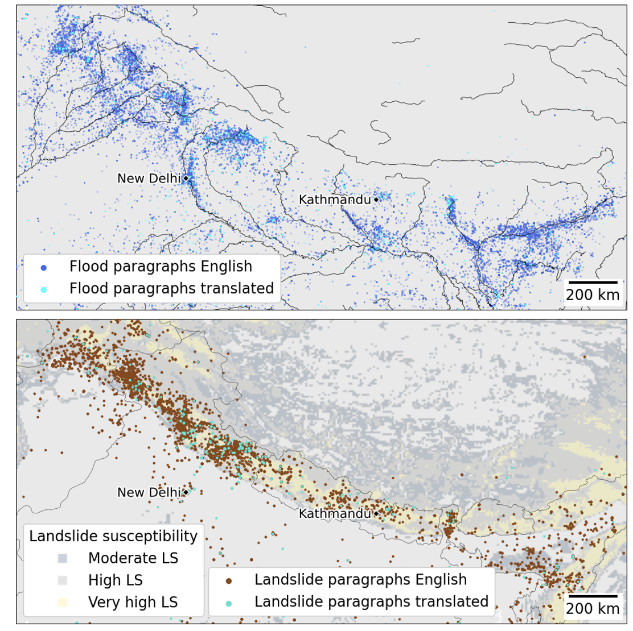
1. Connection between events and paragraphs
2. Background maps
-> Satellite data, precipitation, land use, …

Slide 10
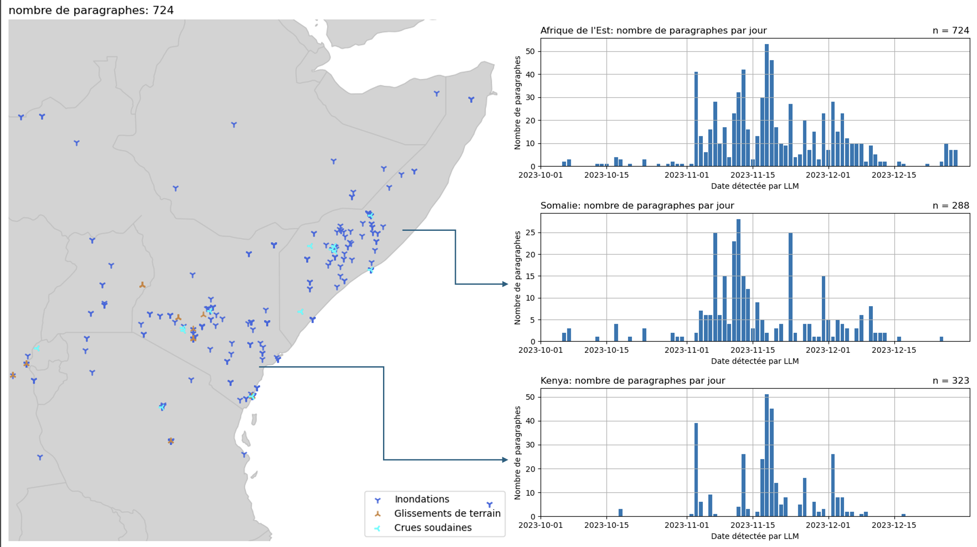

Slide 11
To start
Get familiar with the data
HazMiner
Get ideas from existing tools
Design the interface
Layout and design of the tool
Create interactive maps

